Slide 1
Educ 200C
Wed. Oct 3, 2012

Slide 2
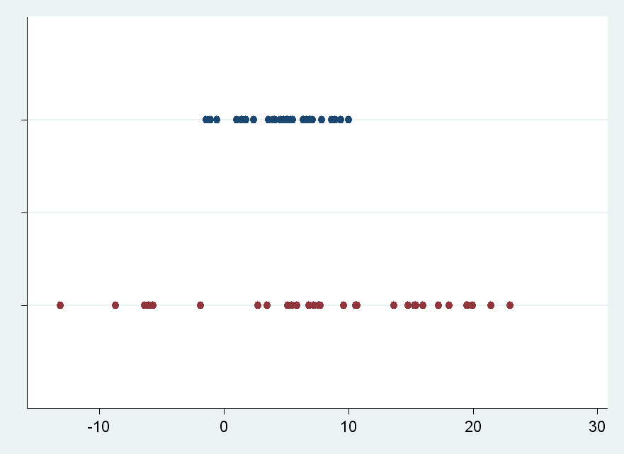
Variation
What is it?
What does it look like in a data set?

Slide 3

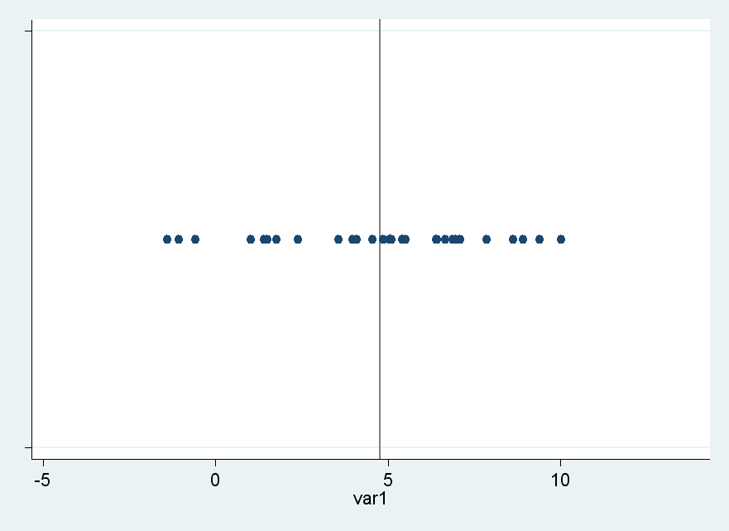
Deviation score
Measure the distance of each point from the mean

Slide 4
Sum of Squares (SS)
What is SS?
When is SS large? When is SS small?
Notes:
Write formula on white board!

Slide 5
Variance and Standard Deviation
Variance is Sum of Squares divided by N-1
  Hard to interpret—still in “squared deviation” units
Standard deviation is the square root of the variance
  Gives a measure of deviation in the units of the original observations

Slide 6
Z-scores
Z-scores always have a mean of 0 and standard deviation of 1
Z-scores make it easier to understand each data point (What does a z-score of 0.2 mean? What about -1.2?)
Z-scores enable us to calculate correlation coefficients.

Slide 7
Correlation Calculation
Similar to how we calculate variation, but consider the deviation of variables from each other rather than from their mean.
Z-score product formula:

Slide 8
What does Z_{x} ∙Z_{y} mean?
As an example, think of Z_{x} and Z_{y} as scores for an individual on two different tests.
What if Z_{x} and Z_{y} are both high?
What if Z_{x} and Z_{y} are both low?
What if they have no relation to each other?
We do this for every pair of points, add them up, and then divide by N to calculate r_{xy}.

Slide 9
Two more formulas (these get you the same r_{xy} )
Z-score difference formula
Raw score formula

Slide 10
What correlation tells you
Correlation tells us how closely related two variables are.
Also, correlation can be used for prediction
  If the correlation between math and reading scores is .67, then if a math score for a student is 1 standard deviation above the mean, then we predict her reading score will be .67 above from the mean.

Slide 11
Back to our hands data—
Let’s calculate…
Mean for estimated and mean for actual
Standard deviation for both sets of data
Z-scores for each data point
Z_{x} ∙Z_{y} for each pair of data points
r_{xy}

Slide 12
Questions?

